Slide 1
Module-10: FSx Assignment - 1
You have been asked to:
Create an FSx file system for a windows file server
Make sure you have AWS Managed Active Directory with a valid domain name
Connect it to your Windows EC2 server
Create an FSx file system for Lustre and attach it to an Amazon Linux 2 instance

Slide 2
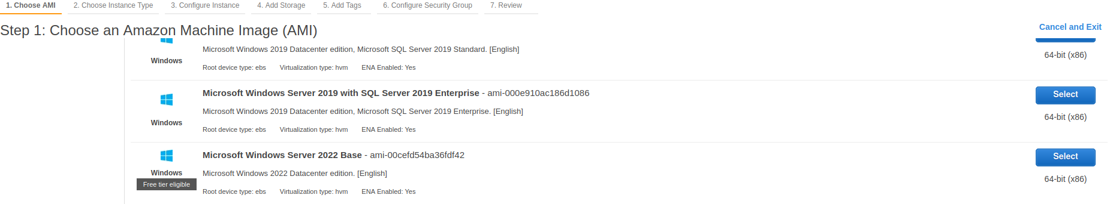
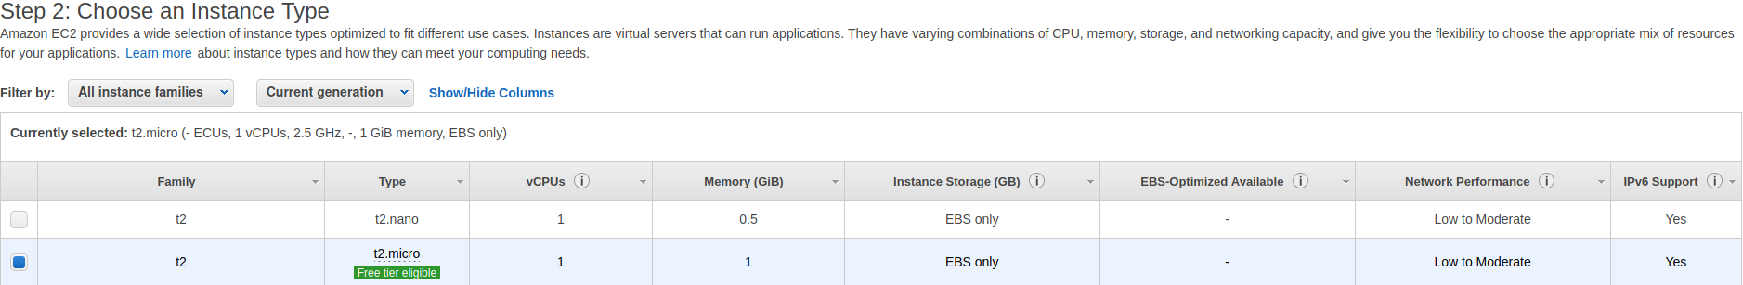
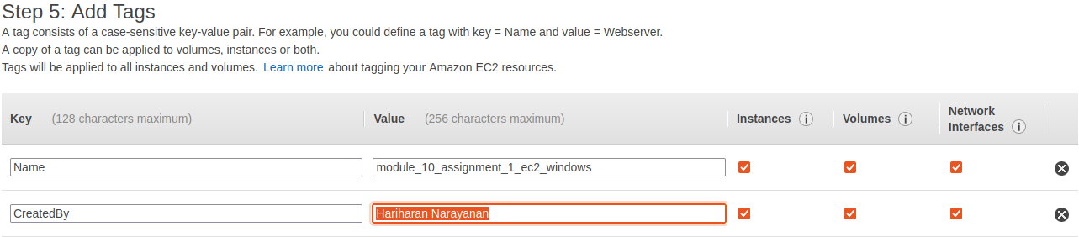
1. Create a Windows EC2 instance

Slide 3
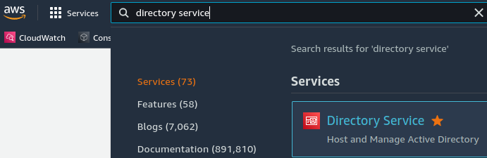
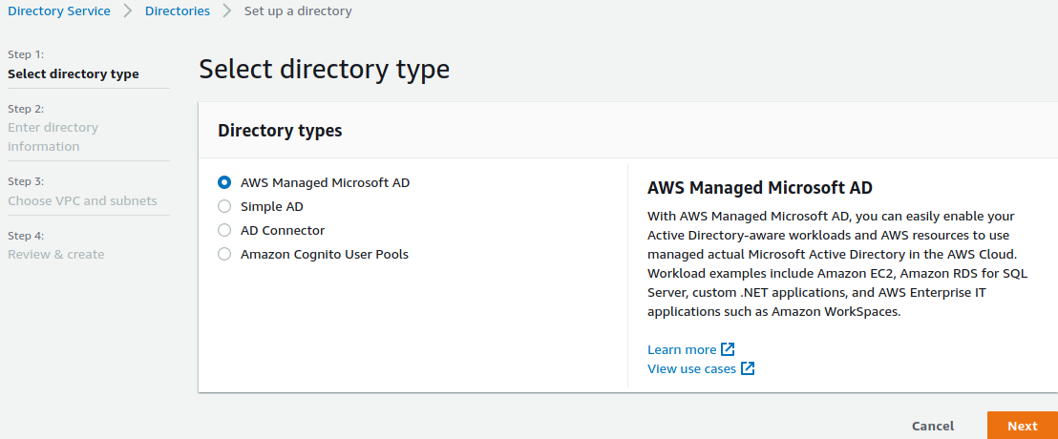
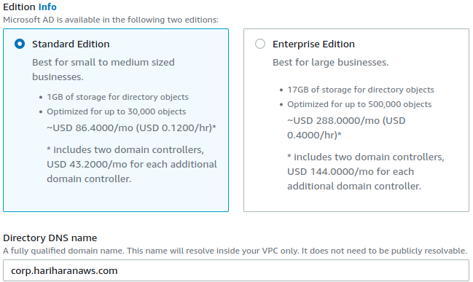
2. Open Directory service
3. Select AWS Managed Microsoft AD
4. Select Standard edition
5. Provide a DNS name to the AD

Slide 4
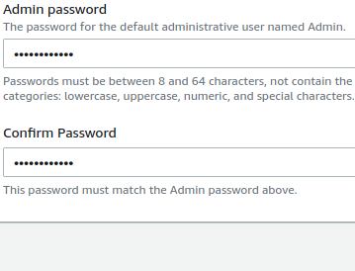
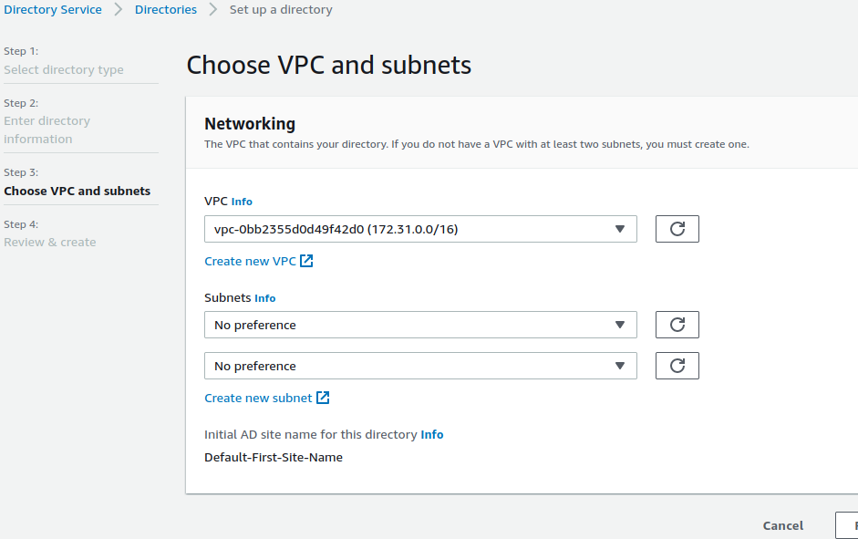
6. Provide password to the AD
7. Provide the VPC (I provided the default VPC).
Save settings, review and create the AD.

Slide 5
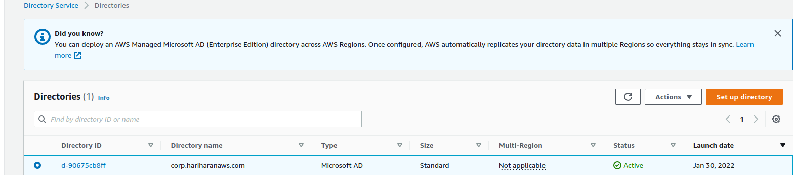
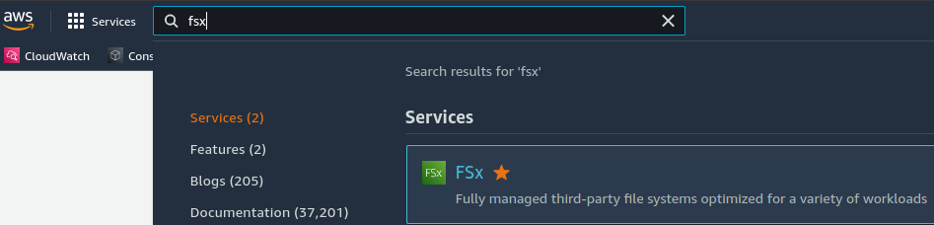
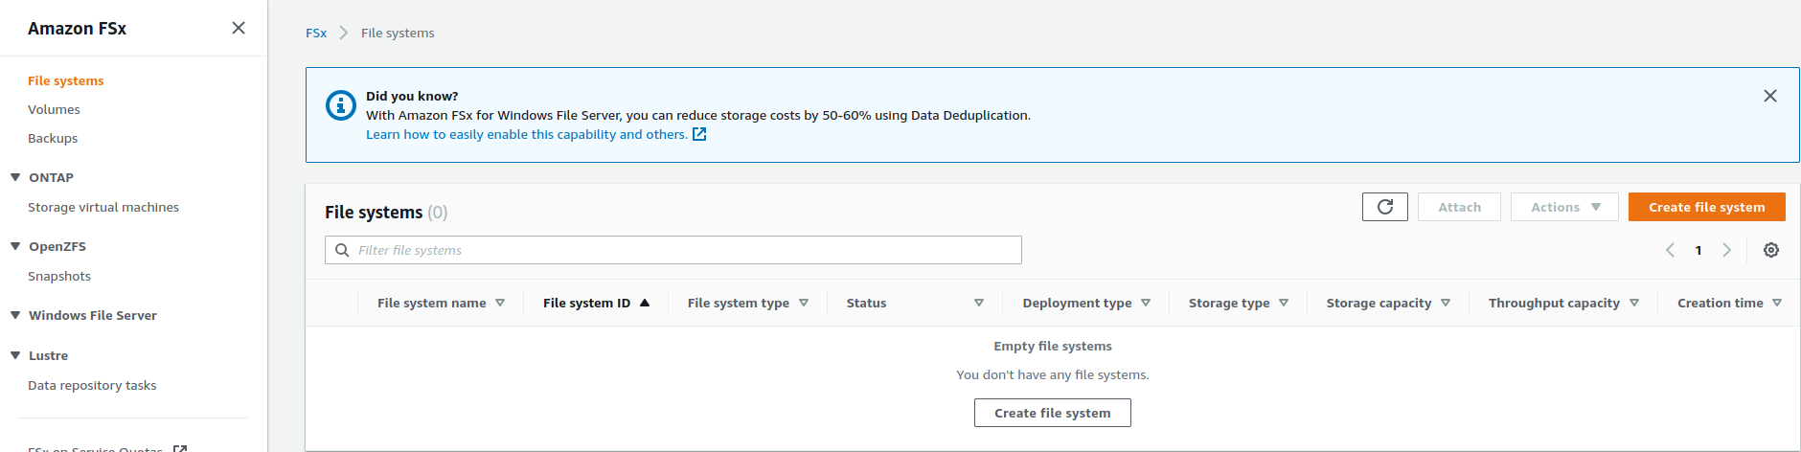
8. Verify that AD is created properly and becomes “Active”.
9. Open Fsx console.
10. Create new file system

Slide 6
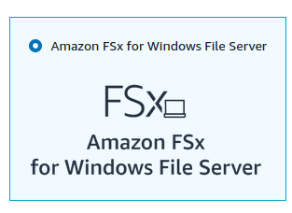
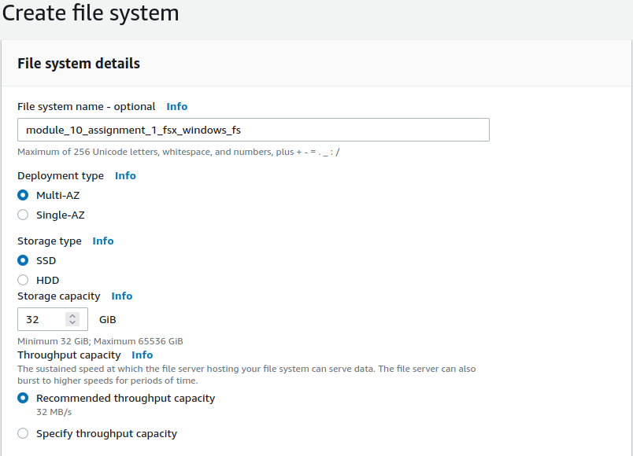
11. Select Windows File server
12. Provide FS name
13. Choose 32GiB as capacity

Slide 7
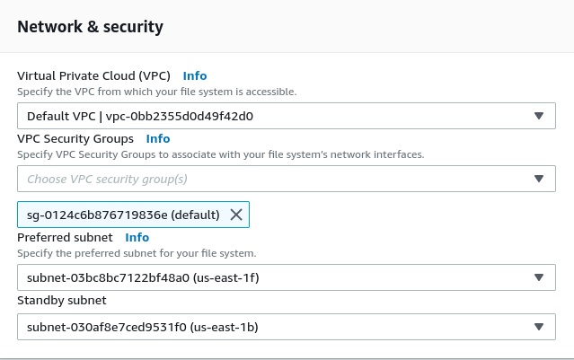
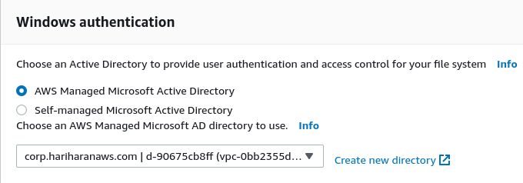
14. Choose default VPC
15. Choose default SG
16. Leave the subnets as chosen
17. Select to attach AWS managed MSFT AD
18. Select the AD we created in (8).
Leave other settings as-is and create FS

Slide 8
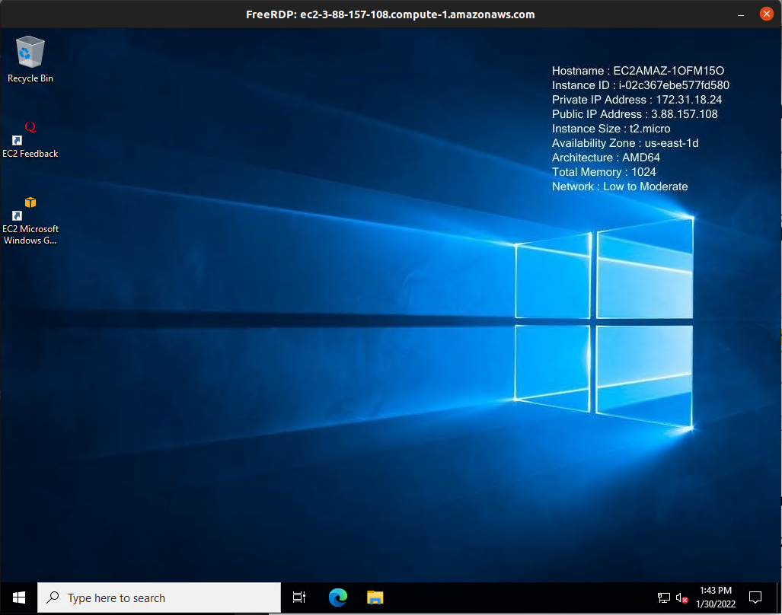
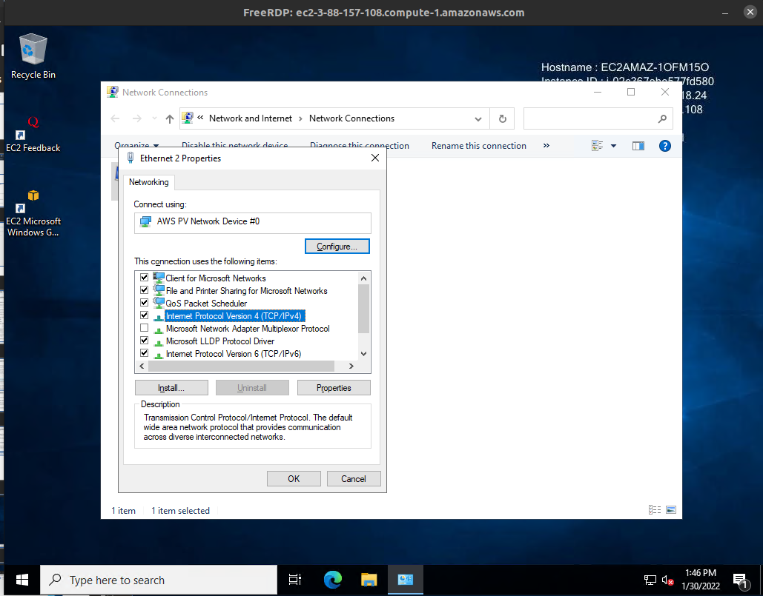
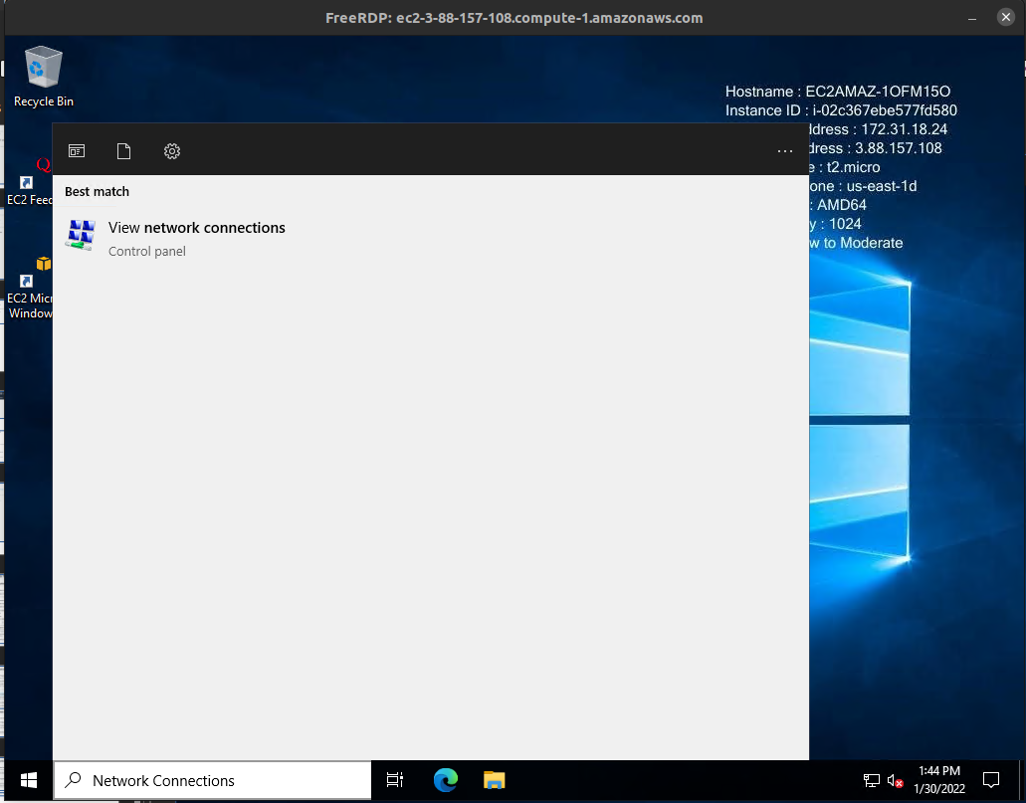
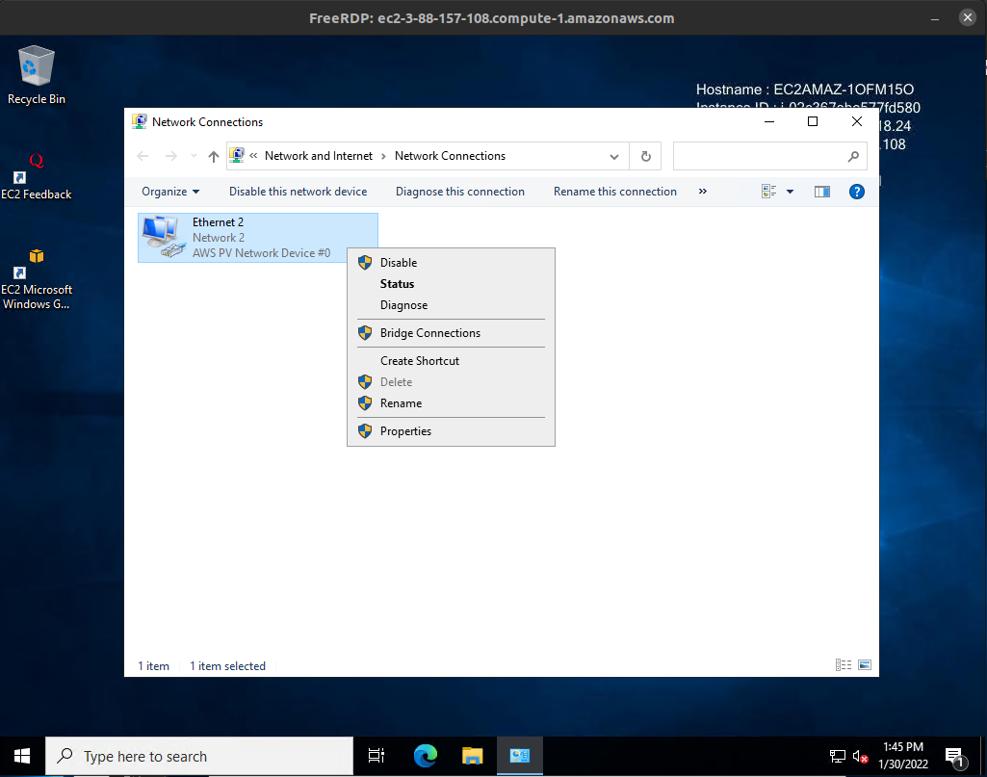
19. Connect to the Windows EC2 instance created in (1), using any RDP client
20. Open Network Connections and Ipv4 Properties

Slide 9
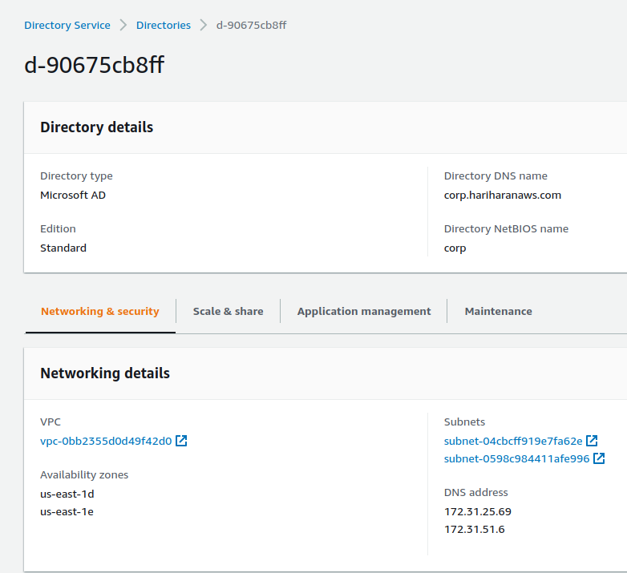
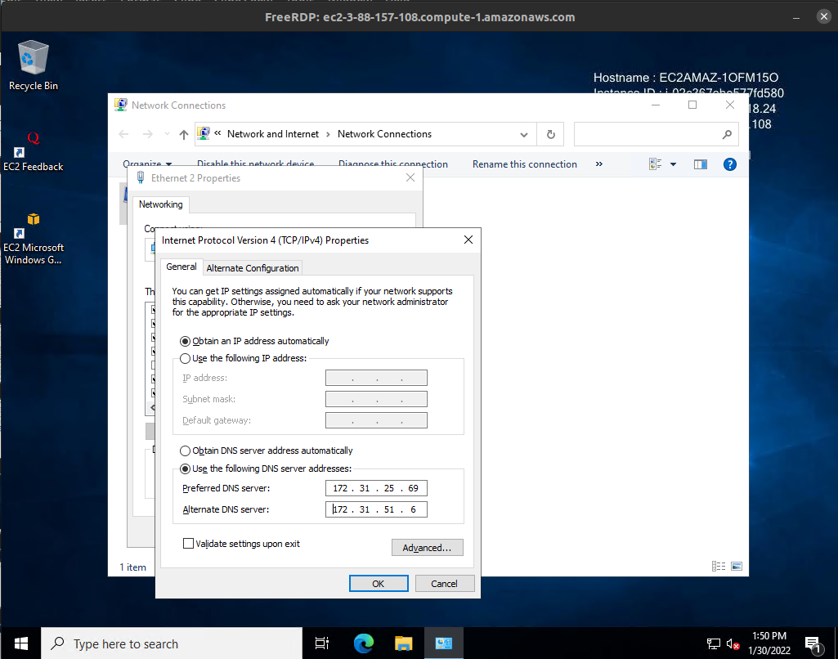
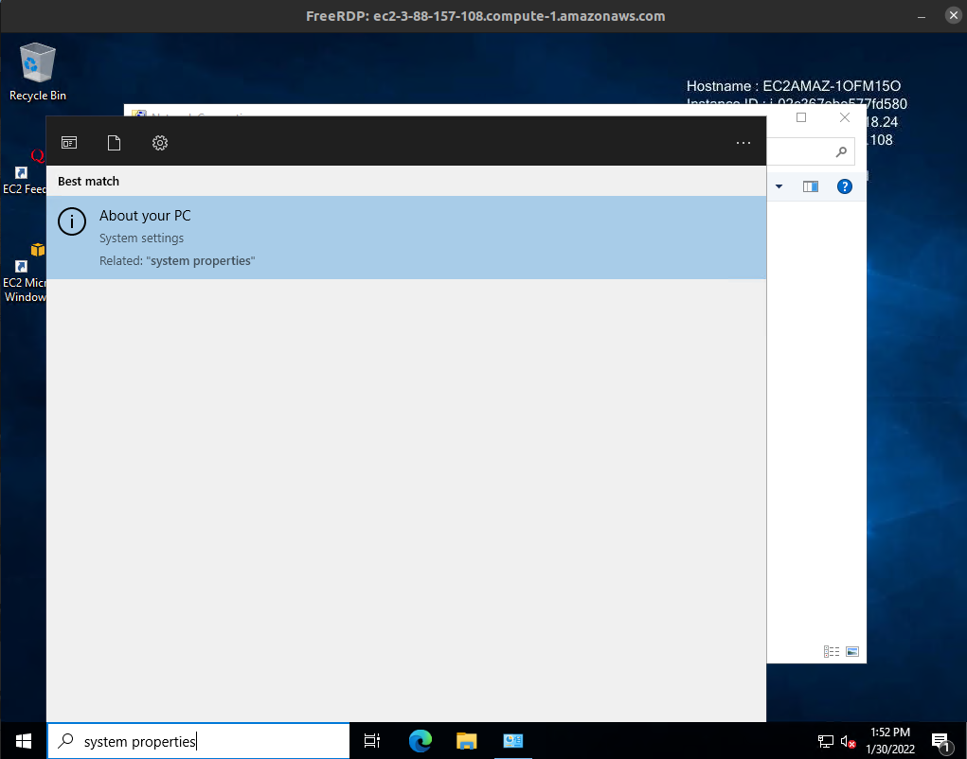
21. Note the DNS addresses of the Windows AD we created
22. Provide the same in the Ipv4 properties DNS server addresses
23. Open PC properties dialog to rename PC

Slide 10
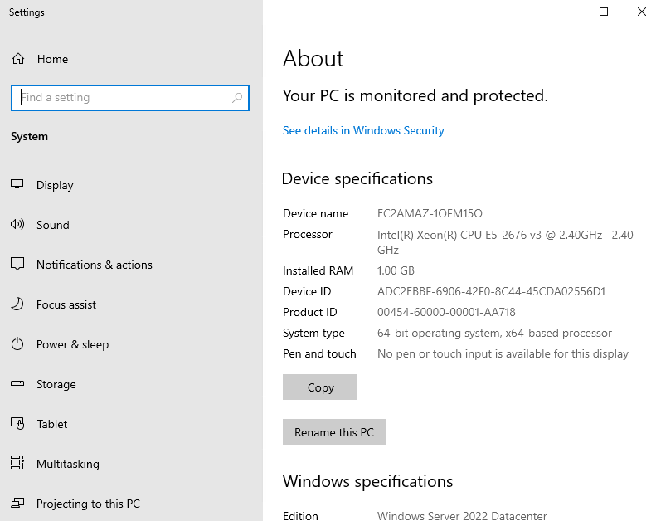
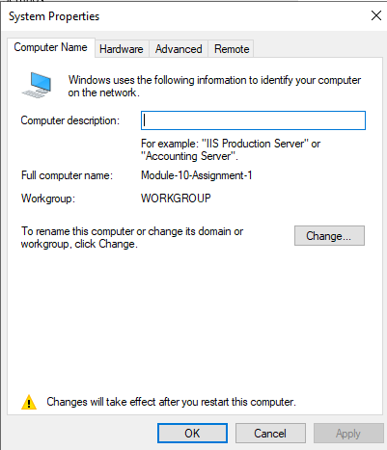
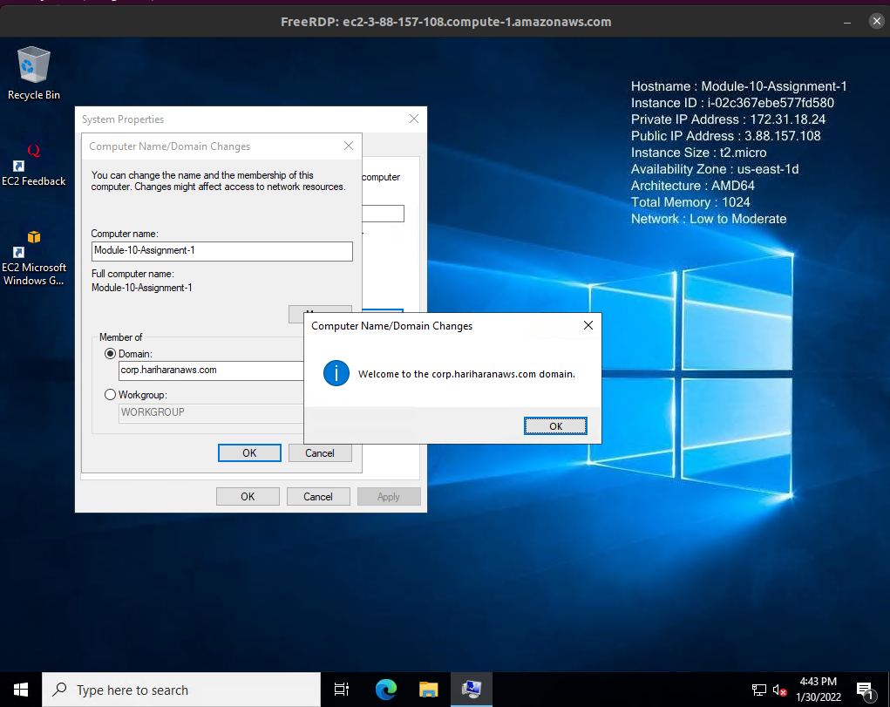
24. Select to rename the PC. After rename, restart the EC2 instance and reconnect using RDP client
25. After restart, open System Properties and “Change” to change domain of this instance
25. After restart, open System Properties and “Change” to change domain of this instance
26. In “Domain”, provide the value of “Directory name” of the Windows AD we created in (8).
Provide username and password of the Admin user we provided in (8)
This finishes parts (1.a) and (1.b) asked in the question

Slide 11
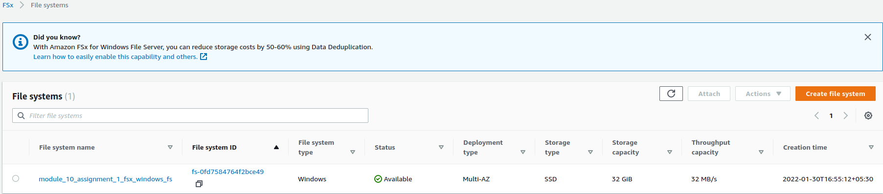
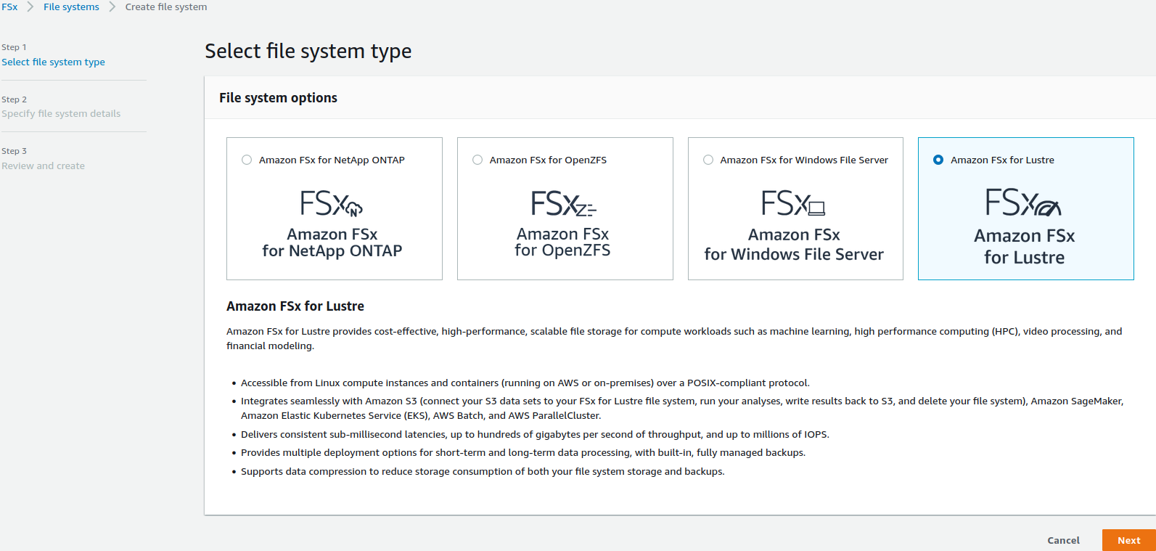
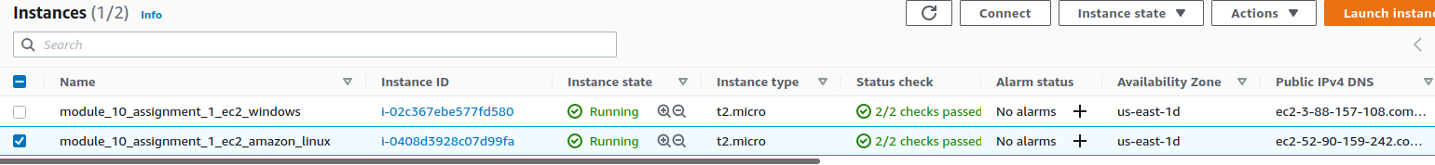
27. Repeat steps (9) and (10) to create another Fsx File System. Choose “Amazon Fsx for Lustre” this time.
28. Create an EC2 instance of Amazon Linux

Slide 12
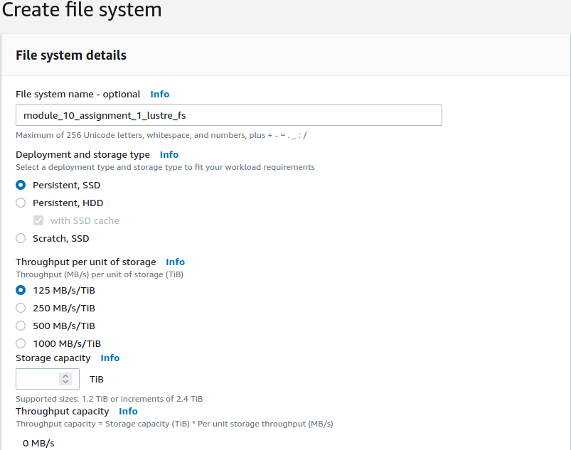
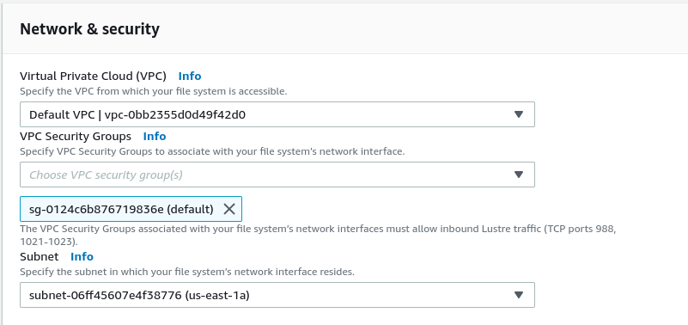
29. Provide a name
31. Provide default VPC
32. Provide default SG
30. Provide 1.2 TiB as default storage capacity
33. Leave subnet as-is

Slide 13
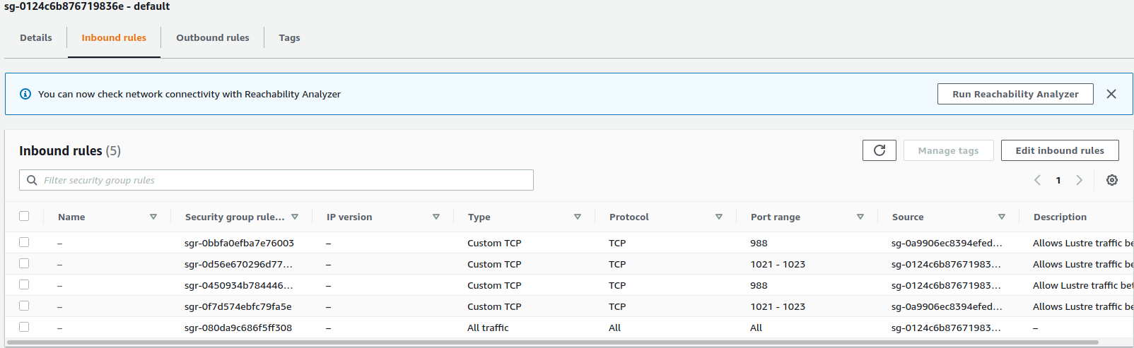
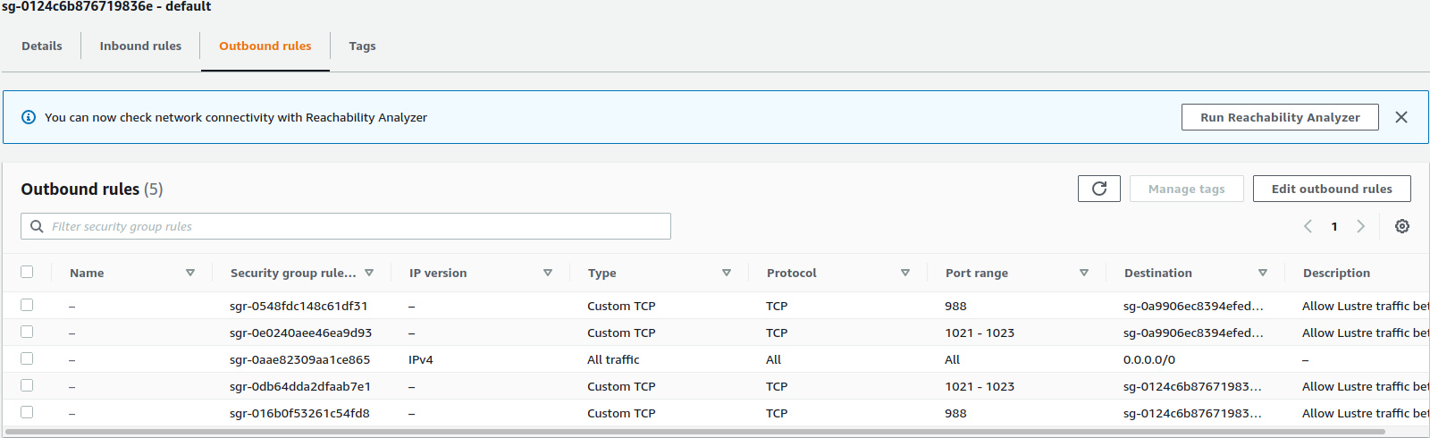
34. Modify inbound rules for default SG to add rules to allow traffic to between Lustre servers and clients.
35. Modify outbound rules for default SG to add rules to allow traffic to between Lustre servers and clients.

Slide 14
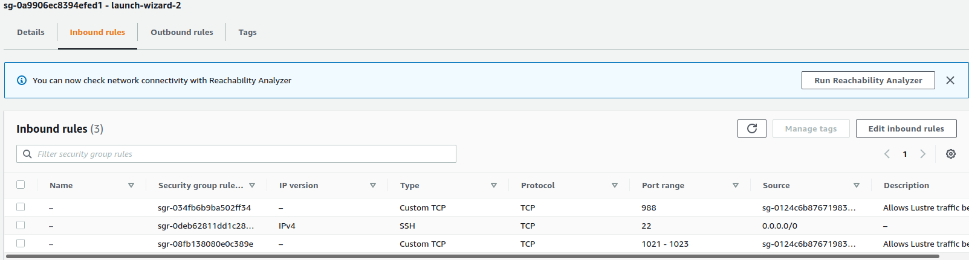
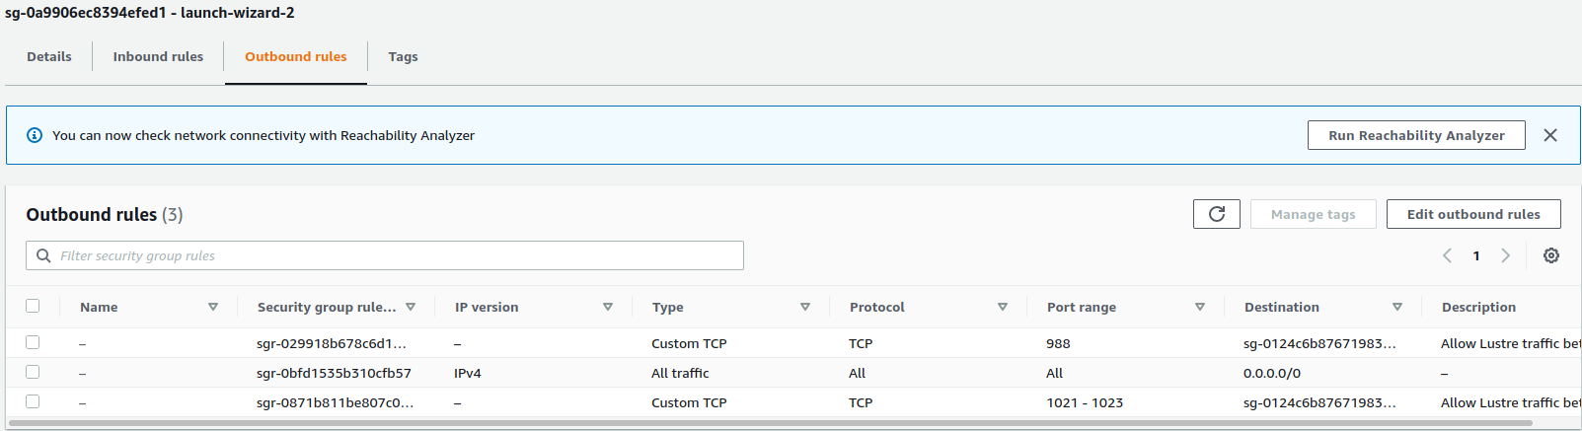
36. Modify inbound rules for SG of Amazon Linux instance created in (28) to add rules to allow traffic to between Lustre servers and clients.
37. Modify outbound rules for SG of Amazon Linux instance created in (28) to add rules to allow traffic to between Lustre servers and clients.

Slide 15
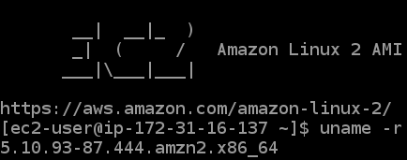
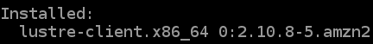
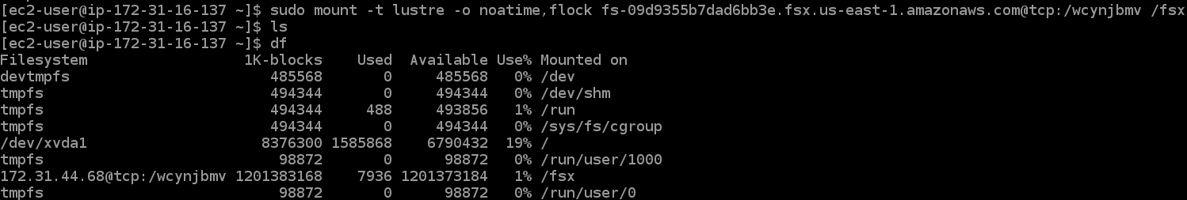
38. Open a SSH session into the Amazon Linux instance created in (28)
39. Install the Lustre file-system client
40. Finally, create a directory called ~/fsx and mount the Lustre filesystem with this directory as the a mount directory. Verify that the file system was mounted correctly.
This finishes part (2) asked in the question

